Slide 1
Chongqing University of Technology
ATAI
Advanced Technique of Artificial Intelligence
Chongqing University of Technology
MODE-LSTM: A Parameter-efficient Recurrent Network with Multi-Scale for Sentence Classification
(EMNLP-2020)
Reported by Ling Zhu
Code:https://github.com/qianlima-lab/MODE-LSTM

Slide 2
Chongqing University of Technology
ATAI
Advanced Technique of Artificial Intelligence
Chongqing University of Technology
1. Introduction
2. Motivation
3. Approach
4. Experiments
5. Conclusion

Slide 3
Introduction
CNN Shortage:May not be sufficient to model the non-consecutive dependency of the phrase and may lose the
sequential information
LSTM Shortage:LSTMs are still biased toward later words and ignoring the earlier words
CNN+RNN Shortage:easily leads to feature redundancy and overfitting because of relatively limited datasets
Notes:
https://blog.csdn.net/weixin_40008135/article/details/111268661

Slide 4
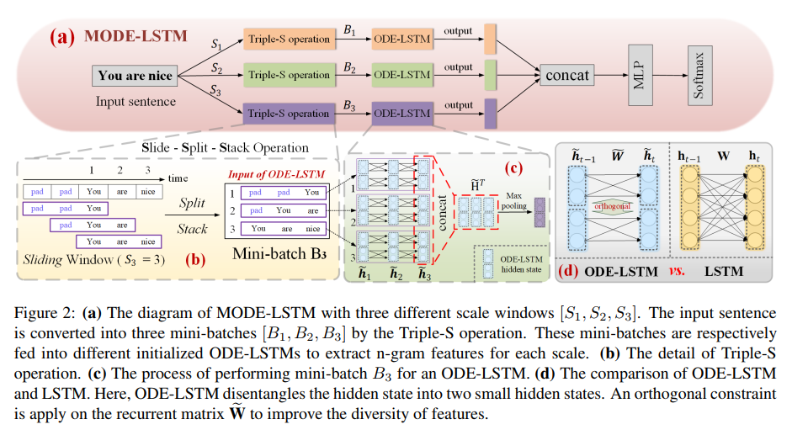
Approach

Slide 5
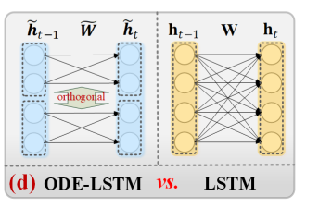
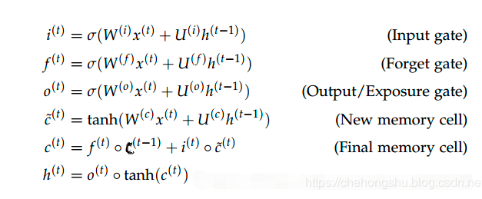
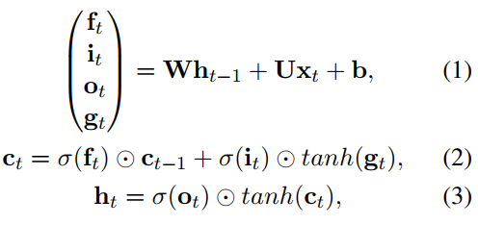
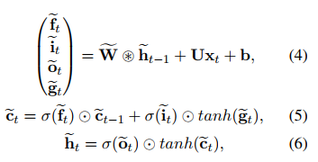
Approach
Orthogonal InDependEnt LSTM (ODE-LSTM)
$$d_{0} :the dimension of input embeddings$$
LSTM hidden state
are the forget, input and output gates respectively
are the learnable parameters.
standard LSTM is a special case of ODE-LSTM when K = 1

Slide 6
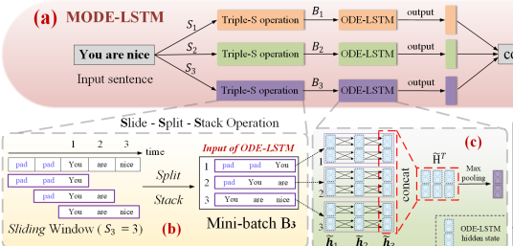
Approach
Equipping ODE-LSTM with Sliding Window
(t−S + 1, t)
M is the number of scales

Slide 7
Approach
MP:MaxPooling

Slide 8
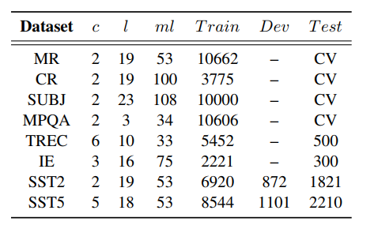
Experiments

Slide 9
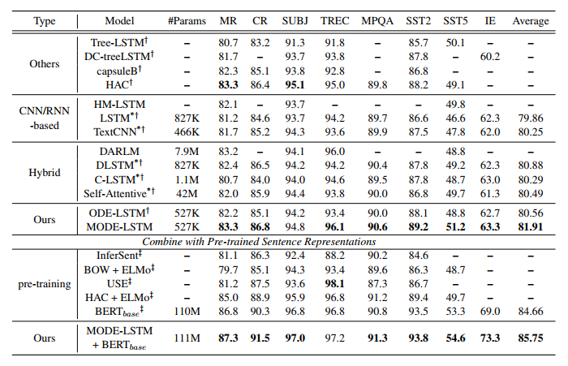
Experiments

Slide 10
Experiments

Slide 11
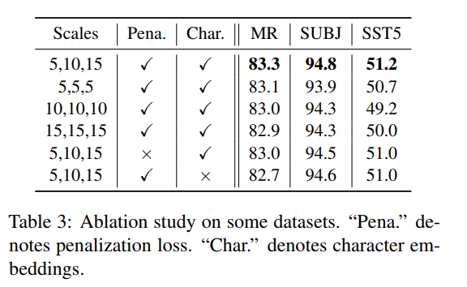
Experiments

Slide 12
Experiments

Slide 13
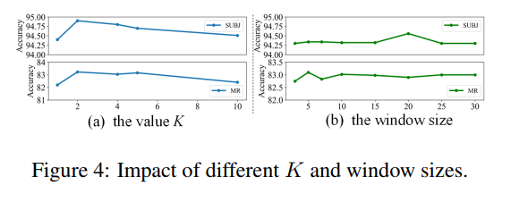
Experiments

Slide 14
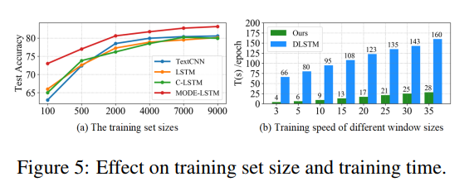
Experiments

Slide 15
Thanks

